Slide 1
Fraudulent Transactions
Task Develop a model for predicting fraudulent transactions for a financial company and use insights from the model to develop an actionable plan. Data for the case is available in CSV format having 6362620 rows and 10 columns.

Slide 2
Different Steps
1. Importing libraries and importing data
2. Data Cleaning
3. Data Visualization and EDA
4.Feature Engineering
5.Data Processing
6.Model
7.Results

Slide 3
1. Importing libraries and importing data
Import all required libraries:
Pandas
It provides ready to use high-performance data structures and data analysis tools.
NumPy
NumPy is a Python library used for working with arrays. It also has functions for working in domain of linear algebra, fourier transform, and matrices.
Matplotlib.pyplot
Matplotlib is a python library used to create 2D graphs and plots by using python scripts.
Seaborn
It is used for data visualization and exploratory data analysis.

Slide 4
2. Data Cleaning
Data cleaning is the process of fixing or removing incorrect, corrupted, incorrectly formatted, duplicate, or incomplete data within a dataset.
After figure out the data I have dropped two columns ['nameOrig', 'nameDest’] from dataset.

Slide 5
3. Data Visualization and EDA
Exploratory Data Analysis (EDA) is a process of describing the data by means of statistical and visualization techniques in order to bring important aspects of that data into focus for further analysis

Slide 6
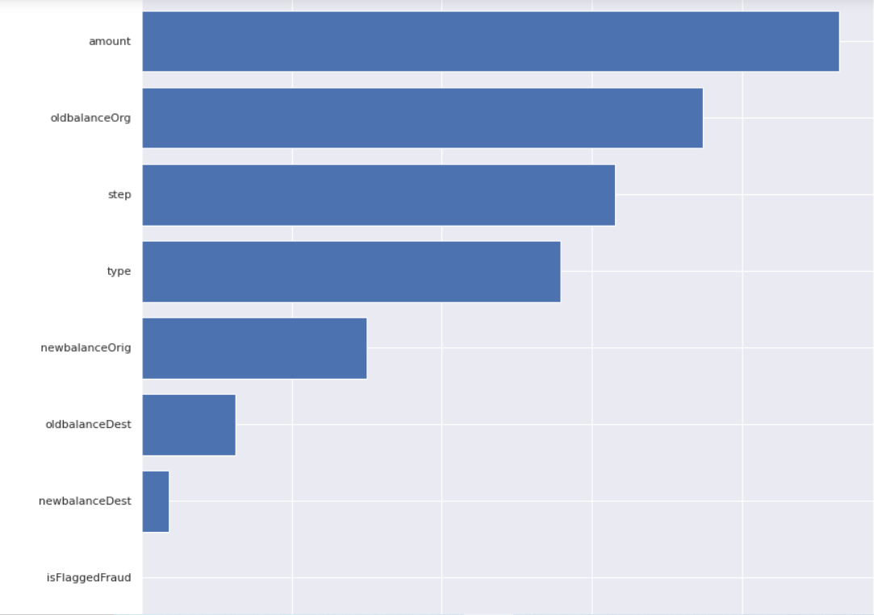
visualize the mutual information scores
As we can see the amount feature tells the most about the transaction being freudulent or not but the isFlaggedFraud does not so it might be better to just drop that feature

Slide 7
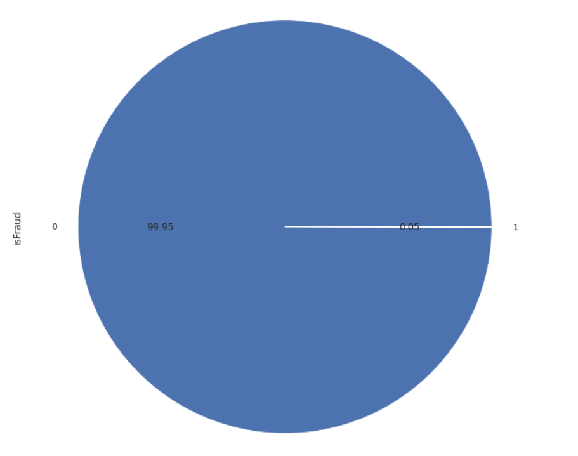
distribution of the isFraud feature
This is just a proportion of the data but we can assume that the other 500,000 chunks behave more or less the same. So unless the features correctly describe a fraudulent transaction we can expect some bias in our model

Slide 8
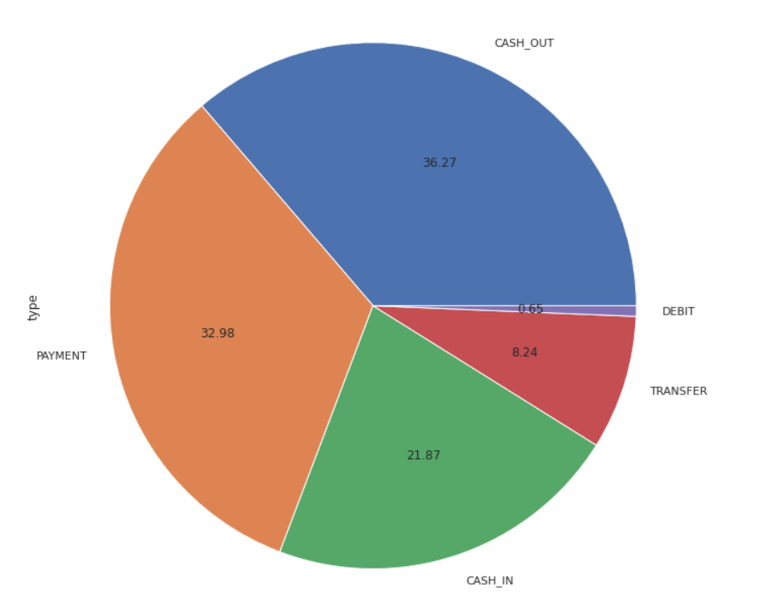
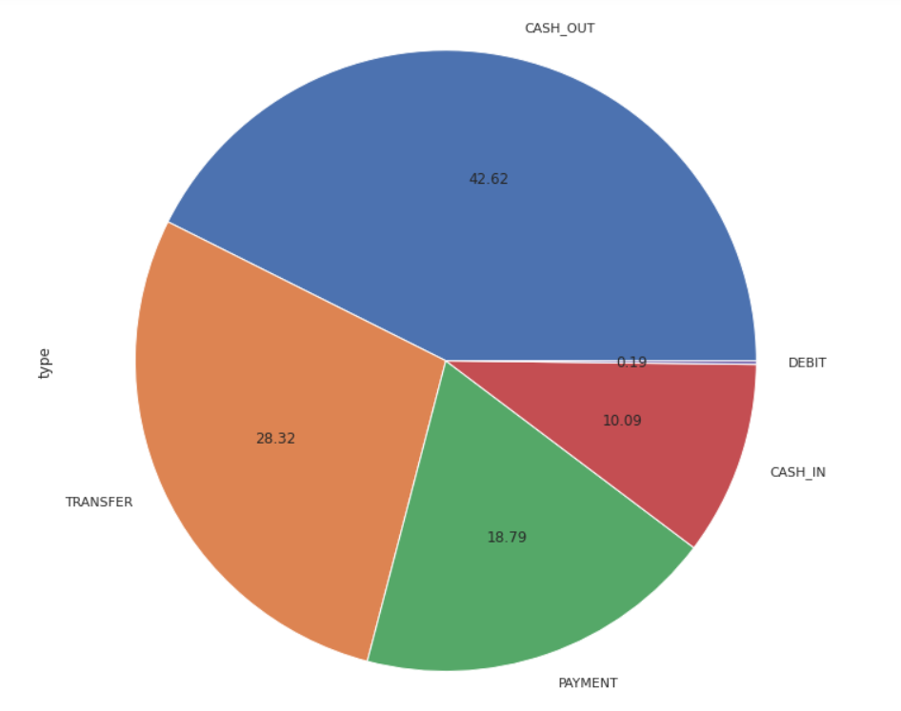
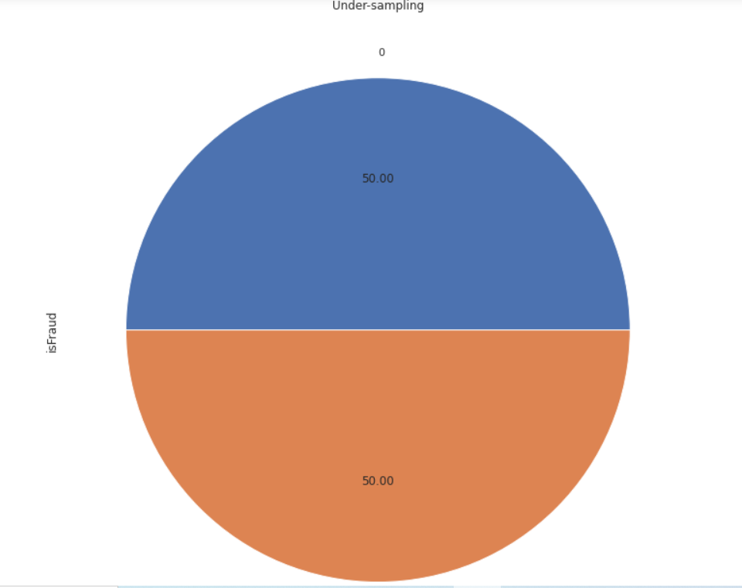
Balance the data out for EDA purposes
As we can see the balanced data does a good job of representing the imbalanced data because they both represent a wide set of entries

Slide 9
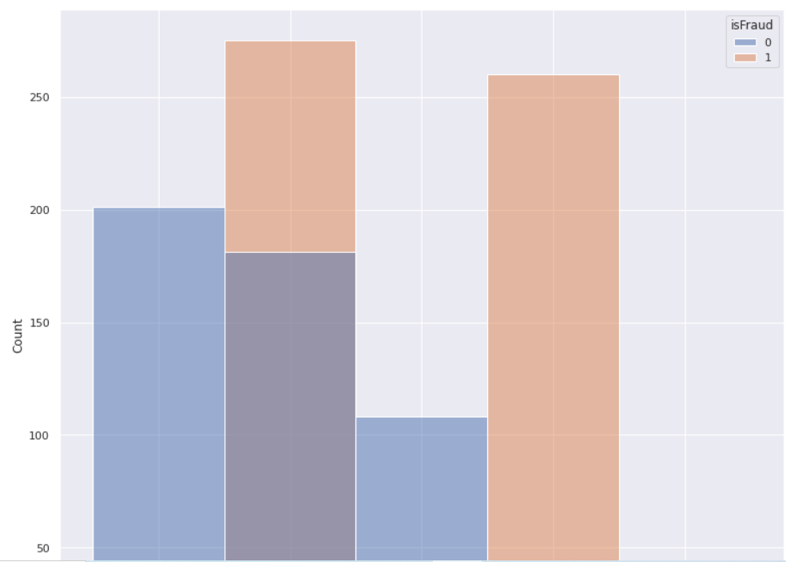
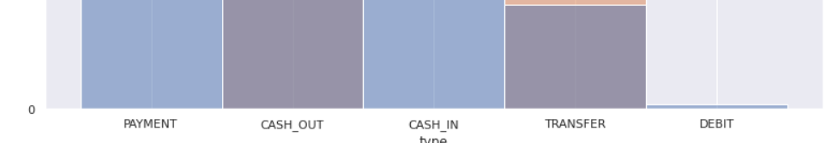
Hist plot for fraudulent transactions
We can see that almost no fraudulent transactions happen by CASH_IN or PAYMENT or DEBIT. They primarily happen by CASH_OUT and TRANSFER. This does make sense as one would try to tranfer the money to their offshore account for example or just take the cash out directly for a less chance of someone tracing the fraud back to them

Slide 10
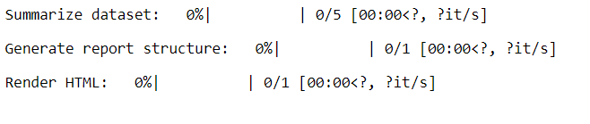
Pandas_profiling library to generate some useful insights

Slide 11
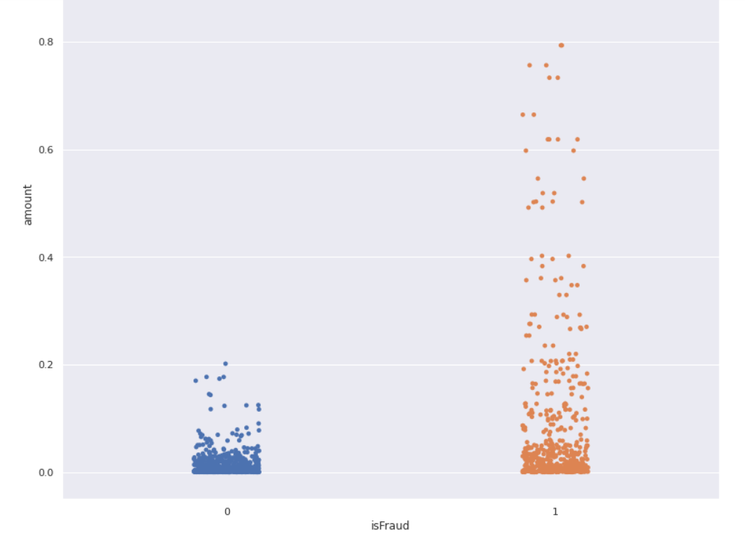
amount Vs isfraud
Here we can clearly see that the fraudulent transactions tend to come at lower amounts but also very high amounts. This shows that people who commit fraud usually will also try to steal a higher amount at one time. Maybe they think that once they do it, they won't be able to do it again using the same accounts so they better get a big amount of money. People who do not commit fraud don't need to do high amount transactions because they can always go and do another transaction, that is why their transaction amounts are lower in comparison to people who commit fraud.

Slide 12
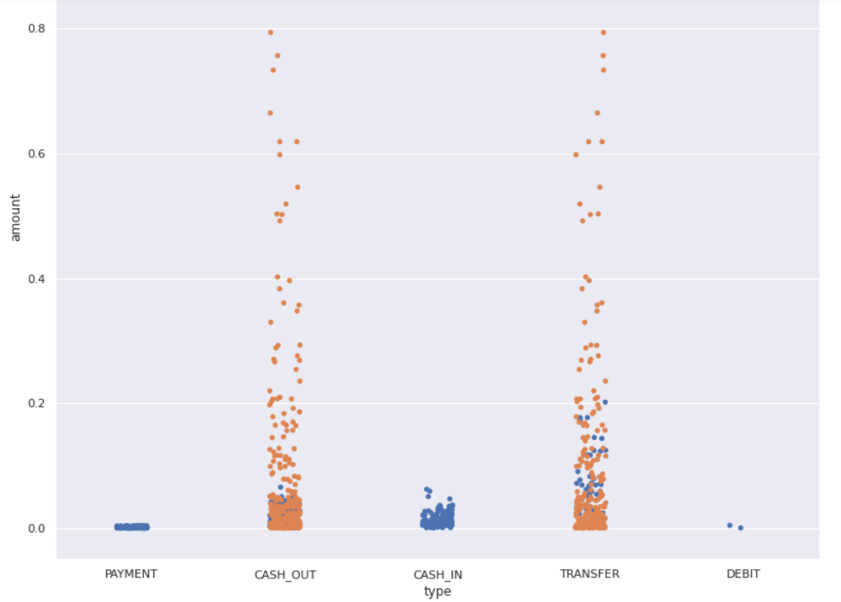
Type of Transaction Vs Amount
Here we can again see the types of transactions used for fraud as we've seen in the graph above but we can also see the amount of a transaction in regards to the type of the transaction. We already knew that Cash and Transfer transactions were the types that were used in fraud but we can also see that because those are the ones used for fraud that they are also the types that include the highest money amount

Slide 13
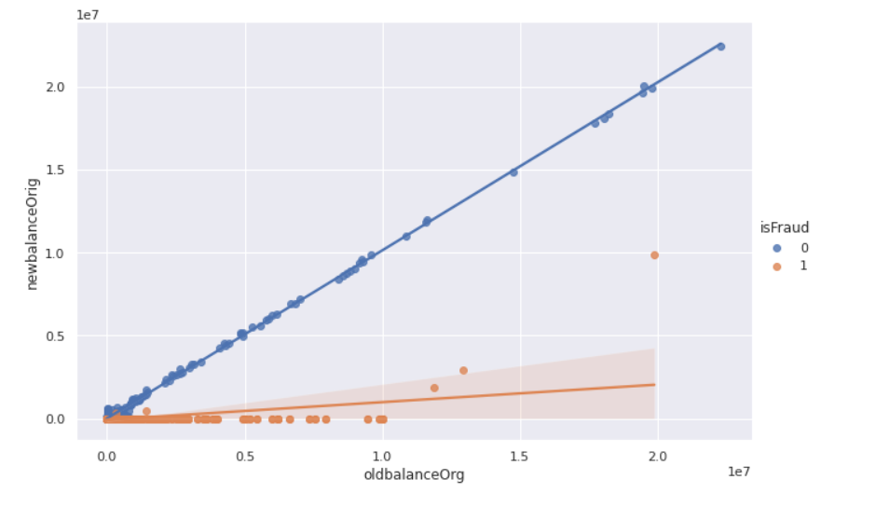
Because of fraudulent activity we can see that most types of fraud will not reflect on the new balance of the account owner

Slide 14
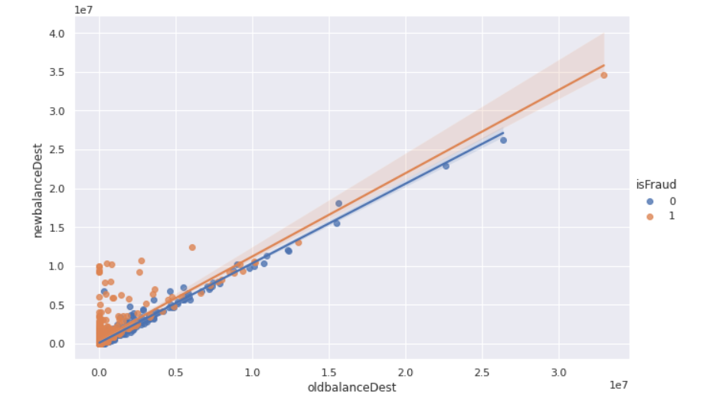
But here you can see that fraudulent activity will not be reflected on the thiefs old account balance because they stole the money
Now....something I find a bit odd is the Step variable. The step might have a hight Mutual Information (MI) score but that doesn't mean that it's useful. So lets look at it in a better light
By definition the step maps a unit of time in the real world. In this case 1 step is 1 hour of time. Total steps 744 (30 days simulation).

Slide 15
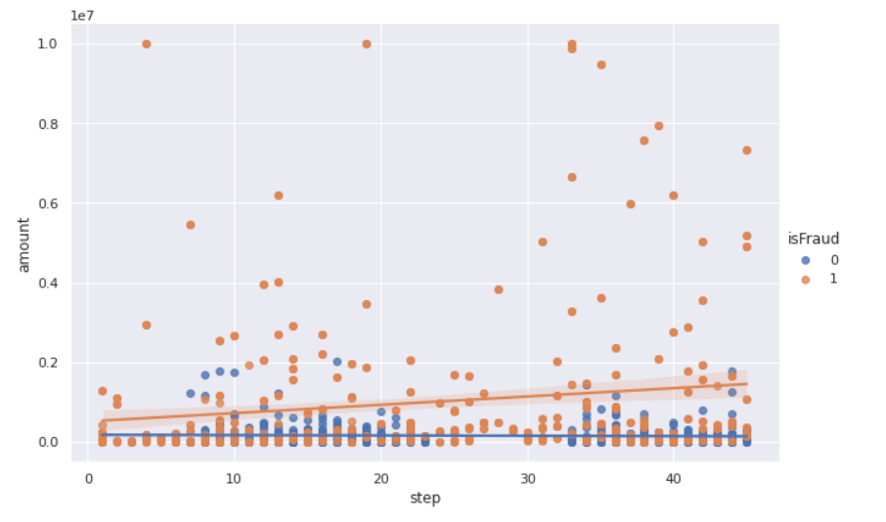
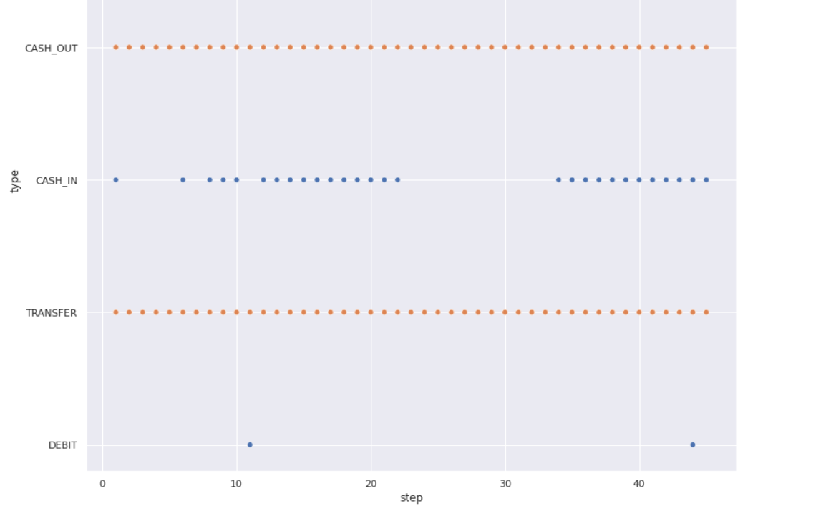
There doesn't seem to be a correlation. Because why would there be ? Fraud isn't predictable by time, is it ? So lets drop this column

Slide 16
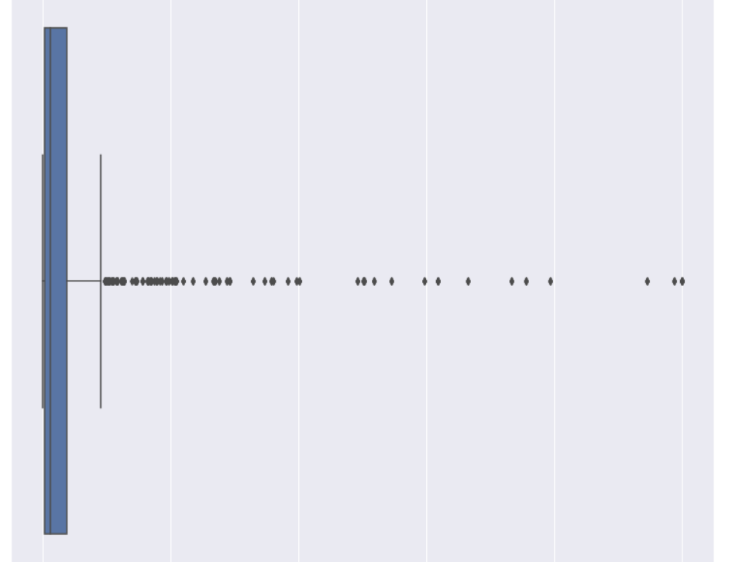
Look onto Outliers
While there are some outliers here most of them look like they are fraud so we''ll keep them

Slide 17
4.Feature Engineering
Feature engineering is a machine learning technique that leverages data to create new variables that aren't in the training set.
I am specifically going to look at oldbalanceOrg and newbalanceOrig to see if we can maybe get the ratio or subtraction as a usefule new feature

Slide 18
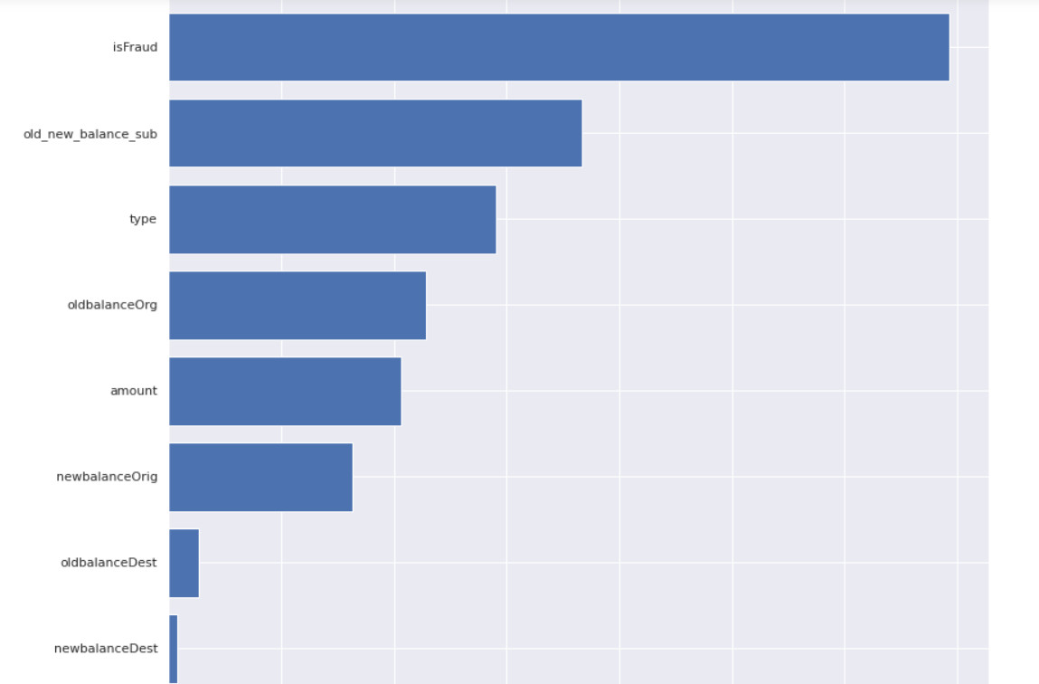
calculate the MI scores
As we can clearly see we have successfully created a new feature that has a large effect on the dependant variable

Slide 19
5.Data Processing
It is a series of calculations or actions that a computer performs on a given set of data to produce a desired result.
when data is collected and translated into usable information.

Slide 20
6.Model
The process of training an ML model involves providing an ML algorithm (that is, the learning algorithm) with training data to learn from.
A machine learning model is a file that has been trained to recognize certain types of patterns

Slide 21
7.Results
Using the SGDClassifier we were able to reach a good model performance but this was only tested with a chunk of the data
Now let's have a final walkthrough of what we did:
We loaded the data and tried to understan it
We cleaned the data and removed faetures that were unimportant
We visualized the data which helped us further understand the data at hand
We generated a new feature which turned out to be a great predicter
We built a model that classified the fraudulent transactions
Imbalanced Data leads to a very low recall score which means that the model fails to classify the fraudulent Transactions so we will have to find a way to balance the data. Right now we do Random Undersampling to achieve that which gets us a good result in terms of accuracy and recall but we loose a lot of data

